Slide 1
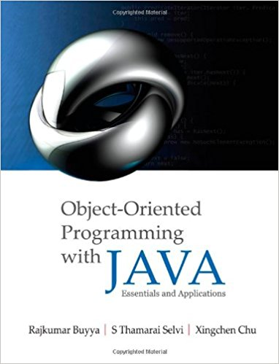
Inter-Process Communication (IPC): Network Programming using TCP Java Sockets
Presented by Dr. Anas Youssef
Lectures made by Dr. Rajkumar Buyya
Cloud Computing and Distributed Systems (CLOUDS) Laboratory
School of Computing and Information Systems
The University of Melbourne, Australia

Slide 2
Agenda
Introduction
Networking Basics
Understanding Ports and Sockets
Java Sockets
Implementing a Server
Implementing a Client
Sample Examples
Conclusions

Slide 3







Introduction
Internet and WWW have emerged as global ubiquitous media for communication and are changing the way we conduct science, engineering, and commerce
They are also changing the way we learn, live, enjoy, communicate, interact, engage, etc. It appears like the modern life activities are getting completely centered around the Internet

Slide 4
Internet Applications Serving Local and Remote Users
PC client
Internet Server
Local Area Network
PDA

Slide 5
Increasing Demand for Internet Applications
To take advantage of opportunities presented by the Internet, businesses are continuously seeking new and innovative ways and means for offering their services via the Internet.
This created a huge demand for software designers with skills to create new Internet-enabled applications or migrate existing/legacy applications to the Internet platform.
Object-oriented Java technologies—Sockets, threads, RMI, clustering, Web services—have emerged as leading solutions for creating portable, efficient, and maintainable large and complex Internet applications.

Slide 6


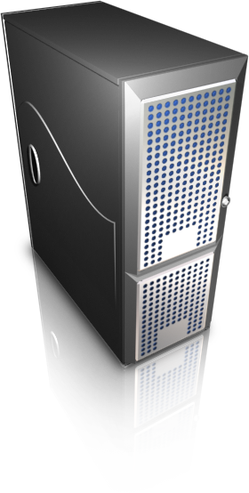
Elements of Client-Server Computing/Communication
a client, a server, and network
request
result
network
client
server
Processes follow protocols that define a set of rules that must be observed by participants:
How the data exchange is encoded?
How events (sending, receiving) are synchronized (ordered) so that participants can send and receive data in a coordinated manner?
In face-to-face communication, humans beings follow unspoken protocols based on eye contact, body language, gesture.

Slide 7
Networking Basics
Physical/Link Layer
Functionalities for transmission of signals representing a stream of data from one computer to another
Internet/Network Layer
IP (Internet Protocols) – a packet of data to be addressed to a remote computer and delivered
Transport Layer
Functionalities for delivering data packets to a specific process on a remote computer
TCP (Transmission Control Protocol)
UDP (User Datagram Protocol)
Programming Interface:
Sockets
Applications Layer
Message exchange between standard or user applications:
HTTP, FTP, Telnet, Skype,…
TCP/IP Stack
Application
(http,ftp,telnet,…)
Transport
(TCP, UDP,..)
Internet/Network
(IP,..)
Physical/Link
(device driver,..)

Slide 8
Networking Basics
TCP (Transmission Control Protocol) is a connection-oriented communication protocol that provides a reliable flow of data between two computers.
Analogy: Speaking on Phone
Example applications:
HTTP, FTP, Telnet
Skype uses TCP for call signalling, and both UDP and TCP for transporting media traffic.
TCP/IP Stack
Application
(http,ftp,telnet,…)
Transport
(TCP, UDP,..)
Internet/Network
(IP,..)
Physical/Link
(device driver,..)

Slide 9
Networking Basics
UDP (User Datagram Protocol) is a connectionless communication protocol that sends independent packets of data, called datagrams, from one computer to another with no guarantees about arrival or order of arrival
Similar to sending multiple emails/letters to friends, each containing part of a message.
Example applications:
Clock server
Ping
Live streaming (event/sports broadcasting)
TCP/IP Stack
Application
(http,ftp,telnet,…)
Transport
(TCP, UDP,..)
Network
(IP,..)
Link
(device driver,..)

Slide 10
TCP Vs UDP Communication
A
B
…
Connection-Oriented Communication
A
B
…
Connectionless Communication

Slide 11
Understanding Ports
The TCP and UDP protocols use ports to map incoming data to a particular process/app running on a computer.
server
P o r t
TCP
Client
app
app
app
app
port
port
port
port
TCP or UDP
Packet
Data
port#
data

Slide 12
Understanding Ports
Port is represented by a positive (16-bit) integer value
Some ports have been reserved to support common/well known services:
FTP 21/tcp
Telnet 23/tcp
SMTP 25/tcp
Login 513/tcp
User-level processes/services generally use port number value >= 1024

Slide 13
Sockets
Sockets provide an interface for programming networks at the transport layer
Network communication using Sockets is very much similar to performing file I/O
In fact, socket handle is treated like file handle.
The data streams used in file I/O operation are also applicable to socket-based I/O
Socket-based communication is programming language independent.
This means, a socket program written in Java language can also communicate to a program written in Java or non-Java socket program
Socket = IP address + Port number

Slide 14
Socket Communication
A server program runs on a specific computer and has a socket that is bound to a specific port. The software server waits and listens to the socket for a client program to make a connection request.
server
Connection request
port
Client

Slide 15
Socket Communication
If everything goes well, the server accepts the connection.
Upon acceptance, the server gets a new socket bounds to a different port. It needs a new socket (consequently a different port number) so that it can continue to listen to the original socket for other connection requests while serving the connected client.
server
port
port
Client
port
Connection

Slide 16
Sockets and Java Socket Classes
A socket is an endpoint of a two-way communication link between two programs running on the network.
A socket is bound to a port number so that the TCP layer can identify the application that data destined to be sent.
Java’s .net package provides two classes:
Socket – for implementing a client
ServerSocket – for implementing a server

Slide 17
Java Sockets
Server
ServerSocket(1234)
Output/write stream
Client
Input/read stream
Socket(“128.250.22.134”, 1234)
It can be host_name like “jarrett.cis.unimelb.edu.au”

Slide 18
Implementing a Server Program
1. Open the Server Socket:
ServerSocket server = new ServerSocket( PORT );
2. Wait for the Client Request:
Socket client = server.accept();
3. Create I/O streams for communicating to the client
DataInputStream is;
DataOutputStream os;
is = new DataInputStream( client.getInputStream() );
os = new DataOutputStream(client.getOutputStream() );
4. Perform communication with client
Receive from client: String line = is.readLine();
Send to client: os.writeBytes("Hello\n");
5. Close sockets: client.close();
For multithreaded server:
while(true) {
i. wait for client requests (step 2 above)
ii. create a thread with “client” socket as parameter (the thread creates streams as in step 3 and does communication as stated in step 4). Remove thread once service is provided.
}

Slide 19
Implementing a Client Program
1. Create a Socket Object:
client = new Socket( server, port_id );
2. Create I/O streams for communicating with the server.
is = new DataInputStream(client.getInputStream() );
os = new DataOutputStream( client.getOutputStream() );
3. Perform I/O or communication with the server:
Receive data from the server:
String line = is.readLine();
Send data to the server:
os.writeBytes("Hello\n");
4. Close the socket when done:
client.close();

Slide 20
A simple server (simplified code)
// SimpleServer.java: a simple server program
import java.net.*;
import java.io.*;
public class SimpleServer {
public static void main(String args[]) throws IOException {
// Register service on port 1234
ServerSocket serverSocket = new ServerSocket(1234);
// Wait and accept a client connection
Socket clientSocket = serverSocket.accept();
// Get a communication stream associated with the client socket
OutputStream clientSocketOutStream = clientSocket.getOutputStream();
DataOutputStream dos = new DataOutputStream (clientSocketOutStream);
// Send a string!
dos.writeUTF("Hi there");
// Close the connection, but not the server socket
dos.close();
clientSocketOutStream.close();
clientSocket.close();
}
}

Slide 21
A simple client (simplified code)
// SimpleClient.java: a simple client program
import java.net.*;
import java.io.*;
public class SimpleClient {
public static void main(String args[]) throws IOException {
// Open your connection to a server, at port 1234
Socket s1 = new Socket(“localhost",1234);
// Get an input file handle from the socket and read the input
InputStream s1In = s1.getInputStream();
DataInputStream dis = new DataInputStream(s1In);
String st = new String (dis.readUTF());
System.out.println(st);
// When done, just close the connection and exit
dis.close();
s1In.close();
s1.close();
}
}

Slide 22
Run
Run Server
java SimpleServer
Run Client Program
java SimpleClient
Hi there
If you run client when server is not up:
sockets [1:147] java SimpleClient
Exception in thread "main" java.net.ConnectException: Connection refused
at java.net.PlainSocketImpl.socketConnect(Native Method)
at java.net.PlainSocketImpl.doConnect(PlainSocketImpl.java:320)
at java.net.PlainSocketImpl.connectToAddress(PlainSocketImpl.java:133)
at java.net.PlainSocketImpl.connect(PlainSocketImpl.java:120)
at java.net.Socket.<init>(Socket.java:273)
at java.net.Socket.<init>(Socket.java:100)
at SimpleClient.main(SimpleClient.java:6)

Slide 23
Socket Exceptions
try {
Socket client = new Socket(host, port); handleConnection(client);
}
catch(UnknownHostException uhe) { System.out.println("Unknown host: " + host); uhe.printStackTrace();
}
catch(IOException ioe) {
System.out.println("IOException: " + ioe); ioe.printStackTrace();
}

Slide 24
ServerSocket & Exceptions
public ServerSocket(int port) throws IOException
Creates a server socket on a specified port
A port of 0 creates a socket on any free port. You can use getLocalPort() to identify the (assigned) port on which this socket is listening
The maximum queue length for incoming connection indications (a request to connect) is set to 50. If a connection indication arrives when the queue is full, the connection is refused
Throws:
IOException - if an I/O error occurs when opening the socket
SecurityException - if a security manager exists and its checkListen method doesn't allow the operation

Slide 25
Server in a Loop: Always up
// SimpleServerLoop.java: a simple server program that runs forever in a single thread
import java.net.*;
import java.io.*;
public class SimpleServerLoop {
public static void main(String args[]) throws IOException {
// Register service on port 1234
ServerSocket s = new ServerSocket(1234);
while(true)
{
// Wait and accept a connection
Socket s1 = s.accept();
// Get a communication stream associated with the socket
OutputStream s1out = s1.getOutputStream();
DataOutputStream dos = new DataOutputStream (s1out);
// Send a string!
dos.writeUTF("Hi there");
// Close the connection, but not the server socket
dos.close();
s1out.close();
s1.close();
}
}
}

Slide 26
Java API for UDP Programming
Java API provides datagram communication by means of two classes
DatagramPacket
DatagramSocket
| Msg | length | Host | serverPort |

Slide 27
UDP Client: Sends a Message and Gets reply
import java.net.*;
import java.io.*;
public class UDPClient
{
public static void main(String args[]){
// args give message contents and server hostname
// "Usage: java UDPClient <message> <Host name> <Port number>"
DatagramSocket aSocket = null;
try {
aSocket = new DatagramSocket();
byte [] m = args[0].getBytes();
InetAddress aHost = InetAddress.getByName(args[1]);
int serverPort = 6789; // Or Integer.valueOf(args[2]).intValue() if use <Port number> args[2]
DatagramPacket request = new DatagramPacket(m, args[0].length(), aHost, serverPort);
aSocket.send(request);
byte[] buffer = new byte[1000];
DatagramPacket reply = new DatagramPacket(buffer, buffer.length);
aSocket.receive(reply);
System.out.println("Reply: " + new String(reply.getData()));
}
catch (SocketException e){System.out.println("Socket: " + e.getMessage());}
catch (IOException e){System.out.println("IO: " + e.getMessage());}
finally
{
if(aSocket != null) aSocket.close();
}
}
}

Slide 28
UDP Sever: repeatedly receive a request and sends it back to the client
import java.net.*;
import java.io.*;
public class UDPServer{
public static void main(String args[]){
DatagramSocket aSocket = null;
try{
aSocket = new DatagramSocket(6789); // fixed port number
byte[] buffer = new byte[1000];
while(true){
DatagramPacket request = new DatagramPacket(buffer, buffer.length);
aSocket.receive(request);
DatagramPacket reply = new DatagramPacket(request.getData(),
request.getLength(), request.getAddress(), request.getPort());
aSocket.send(reply);
}
}catch (SocketException e){System.out.println("Socket: " + e.getMessage());}
catch (IOException e) {System.out.println("IO: " + e.getMessage());}
finally {if(aSocket != null) aSocket.close();}
}
}

Slide 29
Example: MathServer – Demonstrates the use of Sockets
MathServer
(sin, cos, sqrt, etc.)
A Client Program
What is sqrt(4)?
“sqrt 4.0”
“2.0”
A Client Program
What is sin(10)?
A Client
Program in “C”
What is sin(10)?
A Client
Program in “C++”
What is sin(10)?
Notes:
A sample math client-server interaction demonstrating online math server that can perform basic math operations is shown in Fig. 13.6

Slide 30
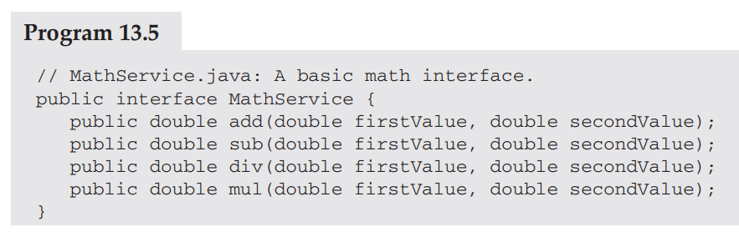
Example: MathServer
What could be the basic interface for usage?
Notes:
The implementation of this interface is not related to any network operation. It demonstrates the services provided by the server

Slide 31
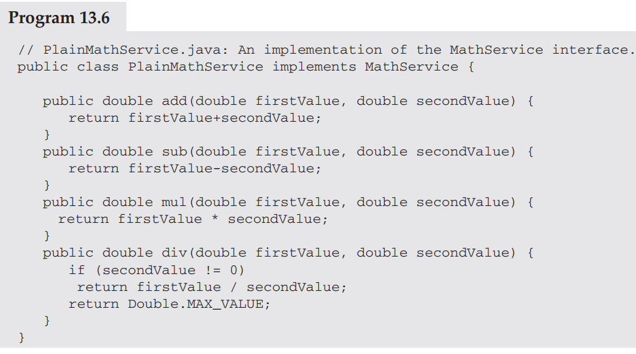
Example: MathServer
Notes:
The above code shows a very simple implementation of this interface:

Slide 32
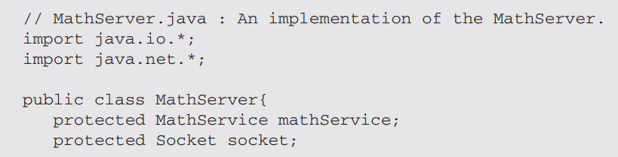
Example 1: MathServer
What could be the implementation MathServer?

Slide 33
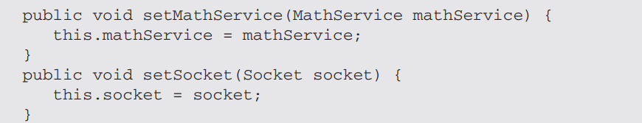
Example 1: MathServer
What could be the implementation MathServer?

Slide 34
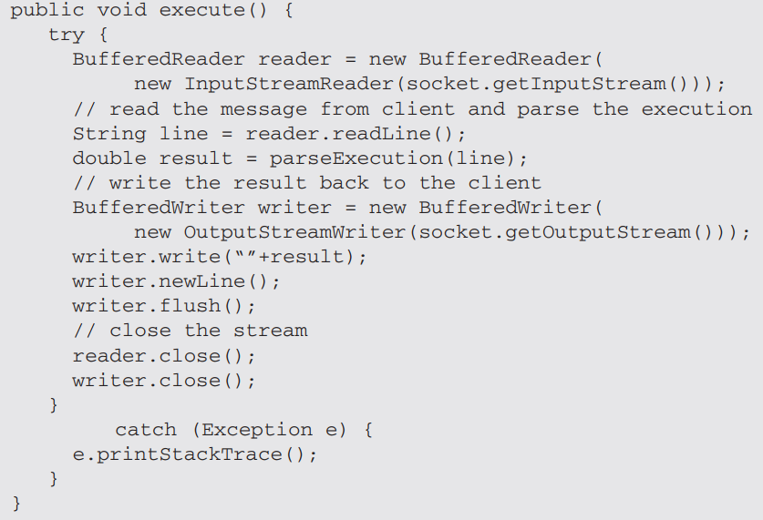
Example 1: MathServer

Slide 35
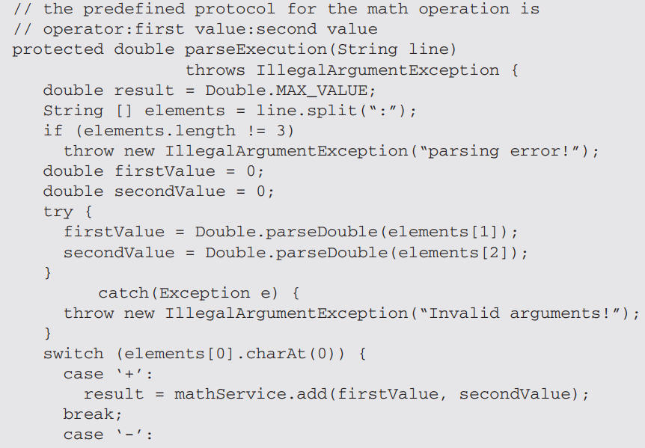
Example 1: MathServer
What could be the implementation MathServer?
Notes:
Notice the protocol part and how there should be a specific non documented interface format for communicqtion

Slide 36
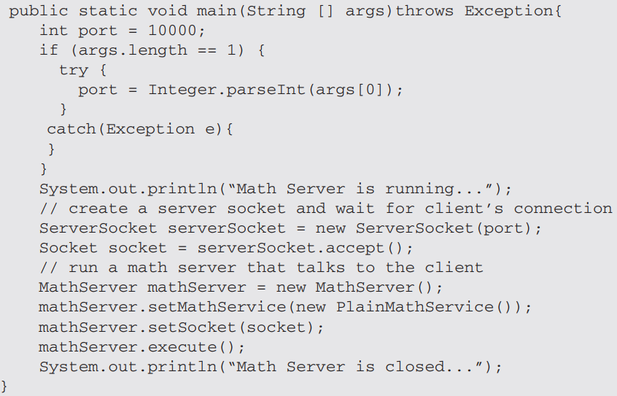
Example: MathServer
What could be the contents of the main methods?
Notes:
Notice the protocol part and how there should be a specific non documented interface format for communicqtion

Slide 37
Example: main() for MathServer

Slide 38
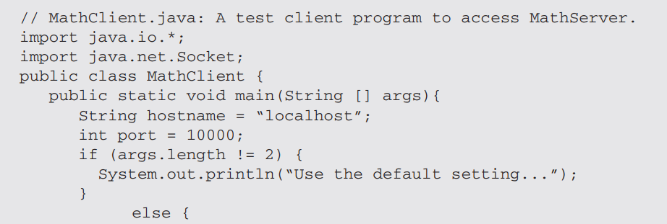
Example 1: Client for MathServer?

Slide 39
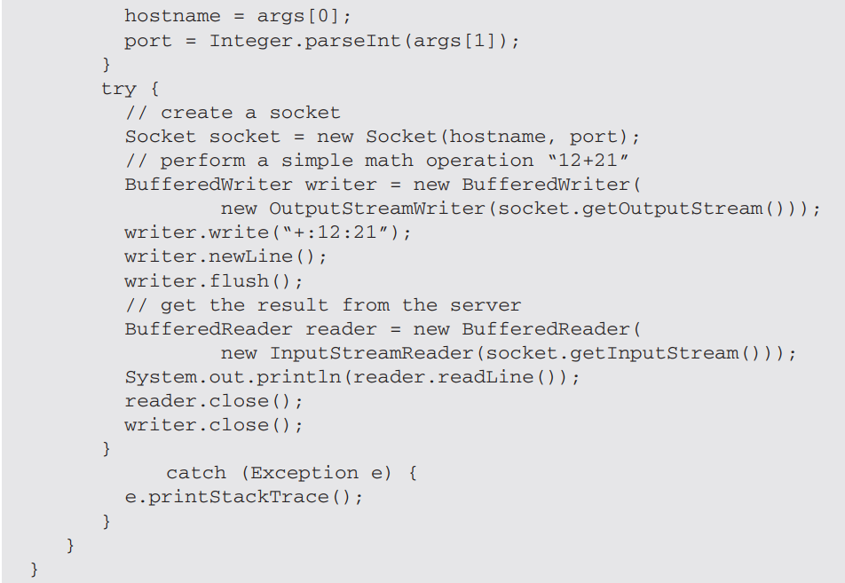
Example 1: Client for MathServer?

Slide 40



Multithreaded Server: For Serving Multiple Clients Concurrently
Server Process
Client Process 2
Server threads
Client Process 1

Slide 41
Summary
Programming client/server applications in Java is fun and challenging
Programming socket programming in Java is much easier than doing it in other languages such as C
TCP for Connection-oriented communication, more reliable, flow control
UDP for connection-less communication
Keywords:
Clients, servers, TCP/IP, port number, sockets, Java sockets

Slide 42
References
Chapter 13: Socket Programming
R. Buyya, S. Selvi, X. Chu, “Object Oriented Programming with Java: Essentials and Applications”, McGraw Hill, New Delhi, India, 2009.
Sample chapters at book website: http://www.buyya.com/java/

